Slide 1
Introduction to Next Generation Sequencing
29 March 2019
Wouter Bossuyt
Genomics Core Leuven

Slide 2
Program

Slide 3
Program

Slide 4
What’s the use of technology if it is not usable?

Slide 5
Mission
Make the NGS revolution a possibility for everyone
Introduce novel technologies as service
Reduce cost by optimizing sequencing
Diagnose patients
Diagnostics
±1500 projects/year
Research
±350 projects/year

Slide 6
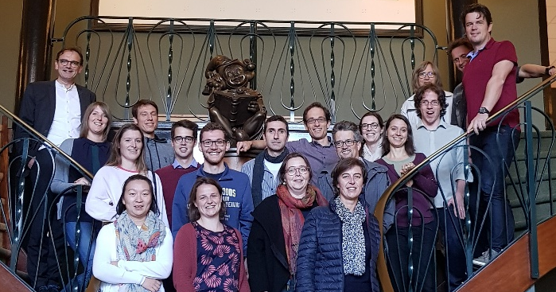
Who are we?
7 wet lab people
9 bio-informaticians
4 supporting people
We are looking for technicians!!

Slide 7
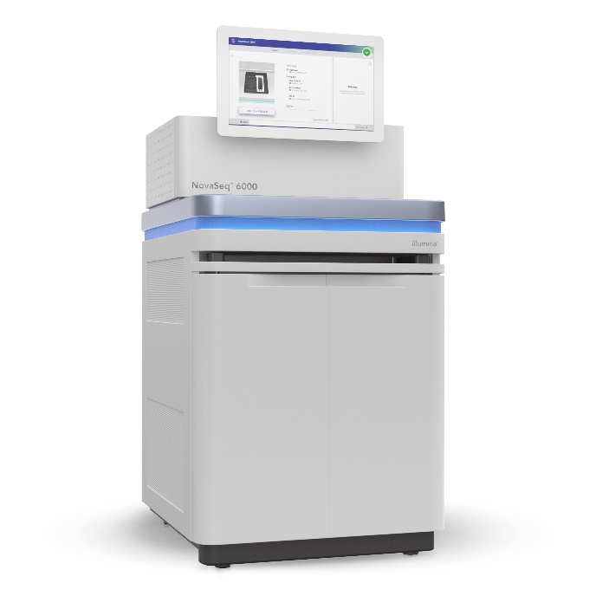
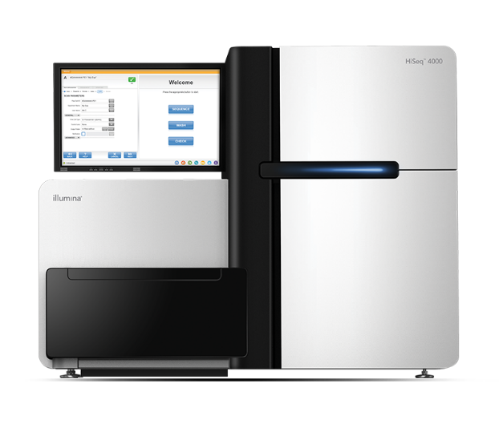
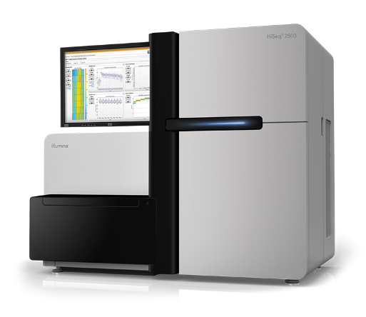
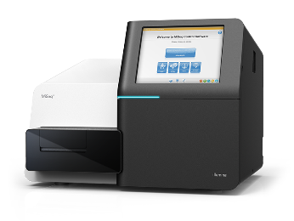
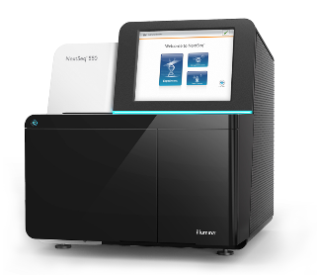
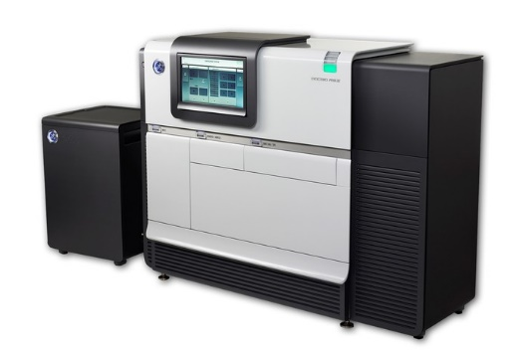
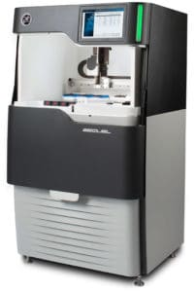
Sequencing
Illumina
Miseq
Nextseq
Hiseq 2500
Hiseq 4000
Novaseq
PacBio
Pacbio RSii
Pacbio Sequel

Slide 8
DNA
RNA
Single cell genomics
Amplicon
MIPs
de novo assembly
Bacterial WGS
Vertebrate WGS
Long read sequencing
Truseq stranded mRNA
Lexogen quantseq
IsoSeq (Pacbio)
DepArray
SMART-seq2
10x Genomics
Sequencing only

Slide 9





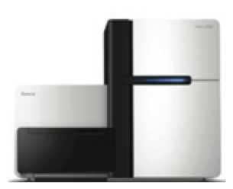

How to get started?
8-10 weeks
request
Library prep and sequencing

Slide 10
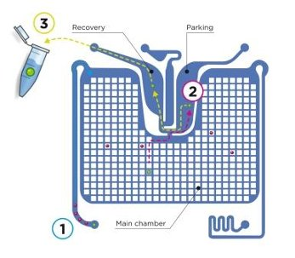
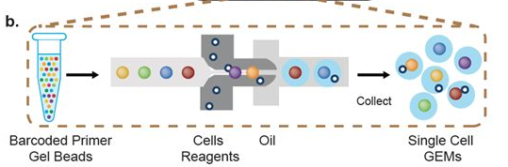
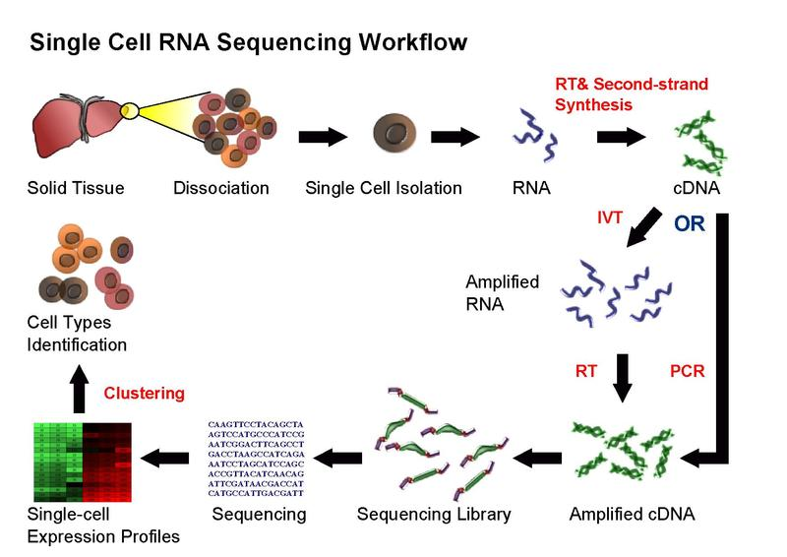
Single cell Core
Sort cells with DepArray
Sort cells and do library prep with 10x Genomics
SmartSeq for single cell transcriptomics

Slide 11

Speed program for fast sequencing
Your data back below 4 weeks
No extra cost
For sequencing-ready libraries taking up an entire run/lane*
Miseq run
Hiseq 2500 PE125 run
Hiseq 4000 SR50 lane
Novaseq run
No library QC from our end!

Slide 12
Data Analysis: What we offer
Always demultiplexed (separate files for separate samples), and mapped for species with references genome
Differential expression analysis included in price of RNAseq library prep
Custom project possible
NEW: Cloud-enabling services

Slide 13
Conclusion
We can do all or just part of the sequencing
Fast is possible for sequencing only
If you want to do sequencing: talk to us!

